Slide 1
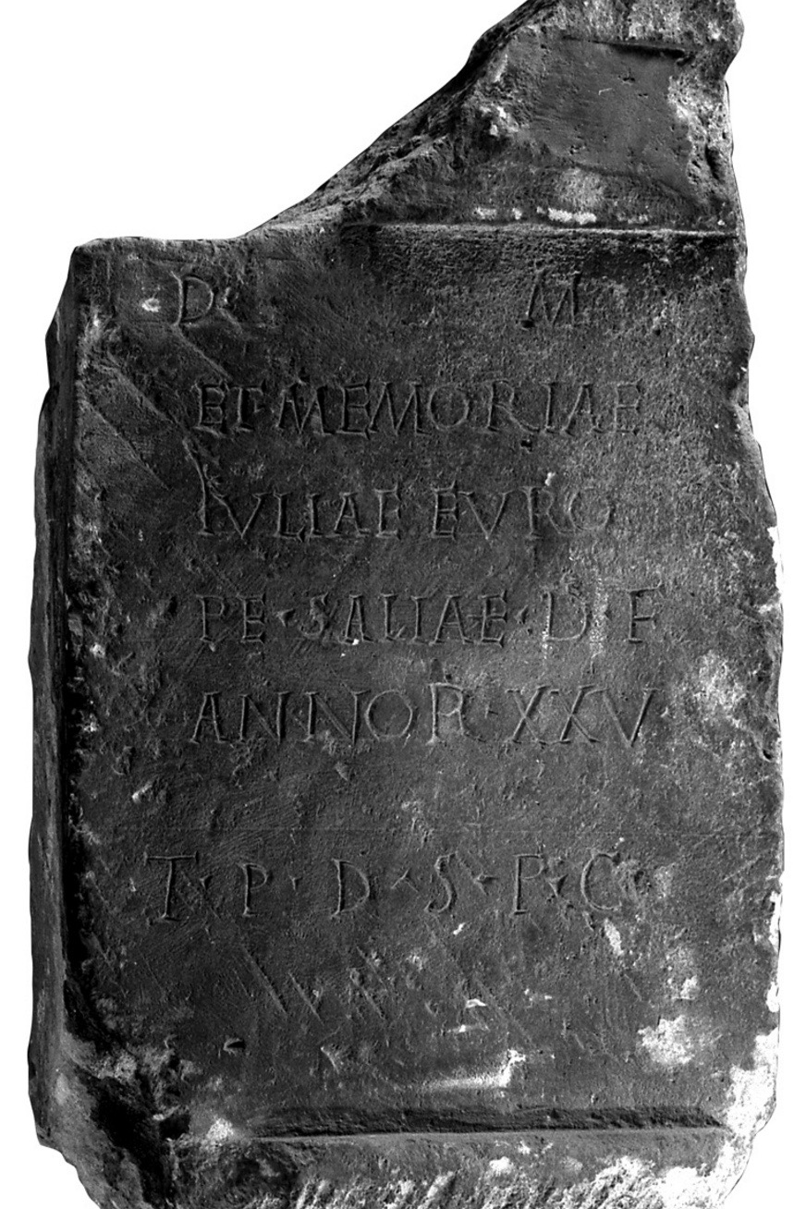
Some Examples of tools to easily publish texts online
Zadar 14.12.2018

Slide 2
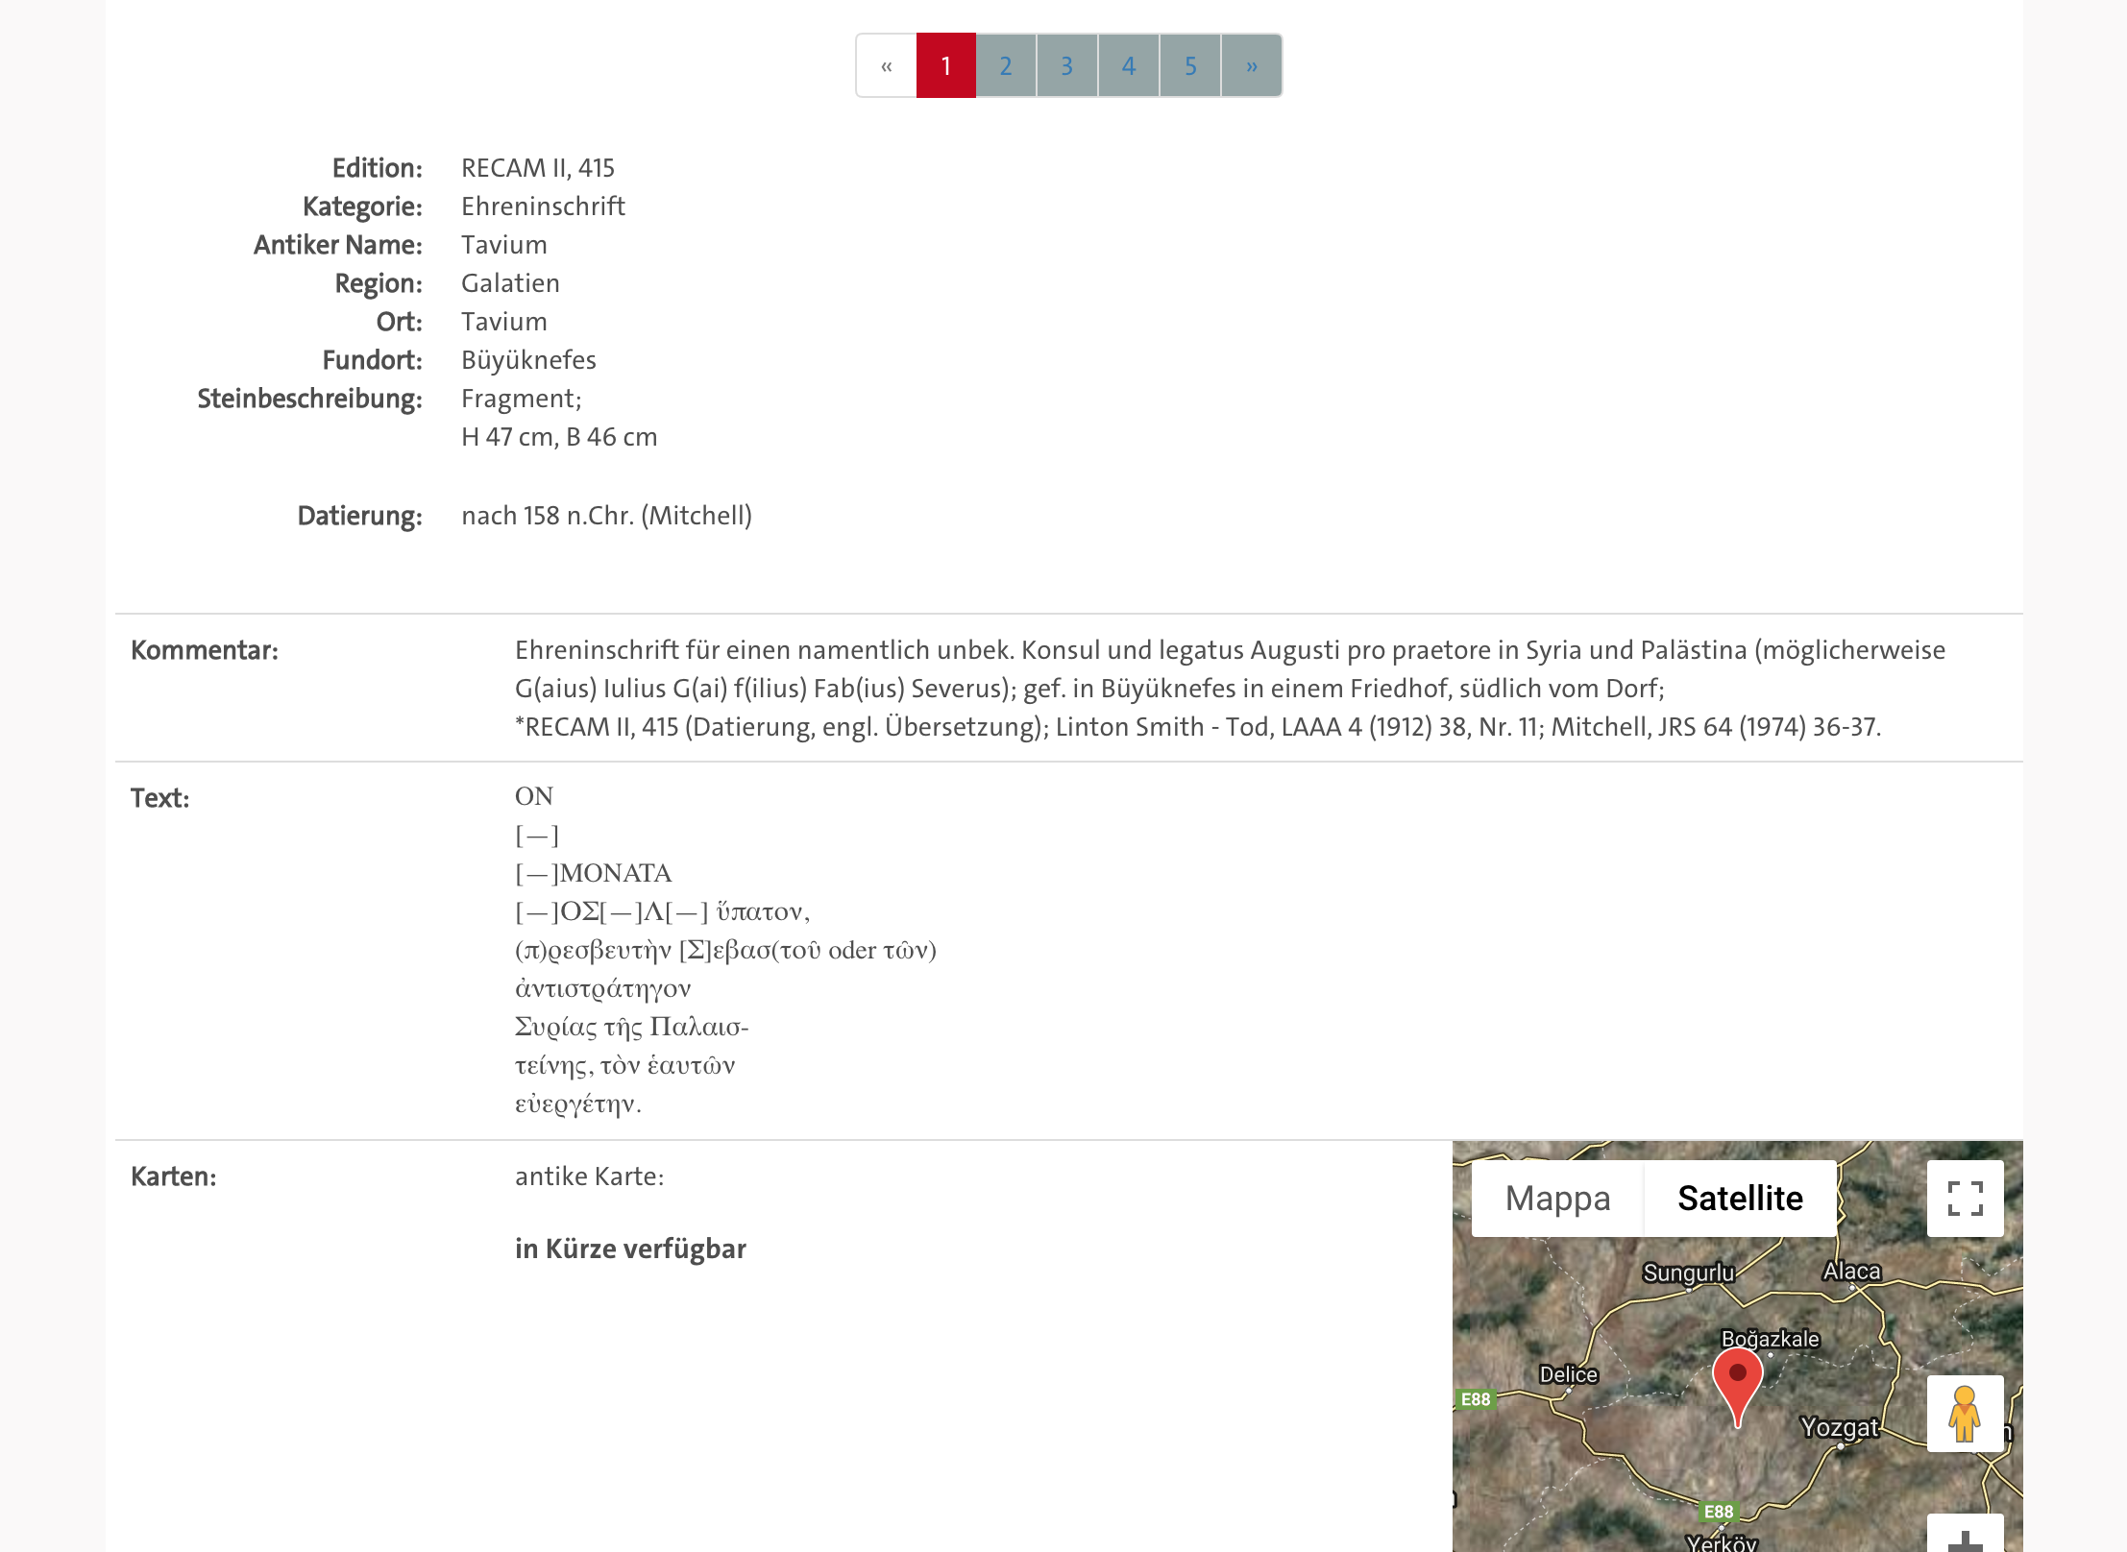
The Example: RECAM II, 415 in the EDAK website
Notes:
THIS DATA HAS BEEN TRANSFORMED TO EPIDOC WITH THE EAGLE UPCONVERSION SCRIPTS, THE EPIDOC IS VALID, NOT PERFECT!

Slide 3

TEI Publisher
Requires eXist / server side
Does already a lot of the search and the export
Easy and nice to customize
Works directly on your XML
https://teipublisher.com

Slide 4
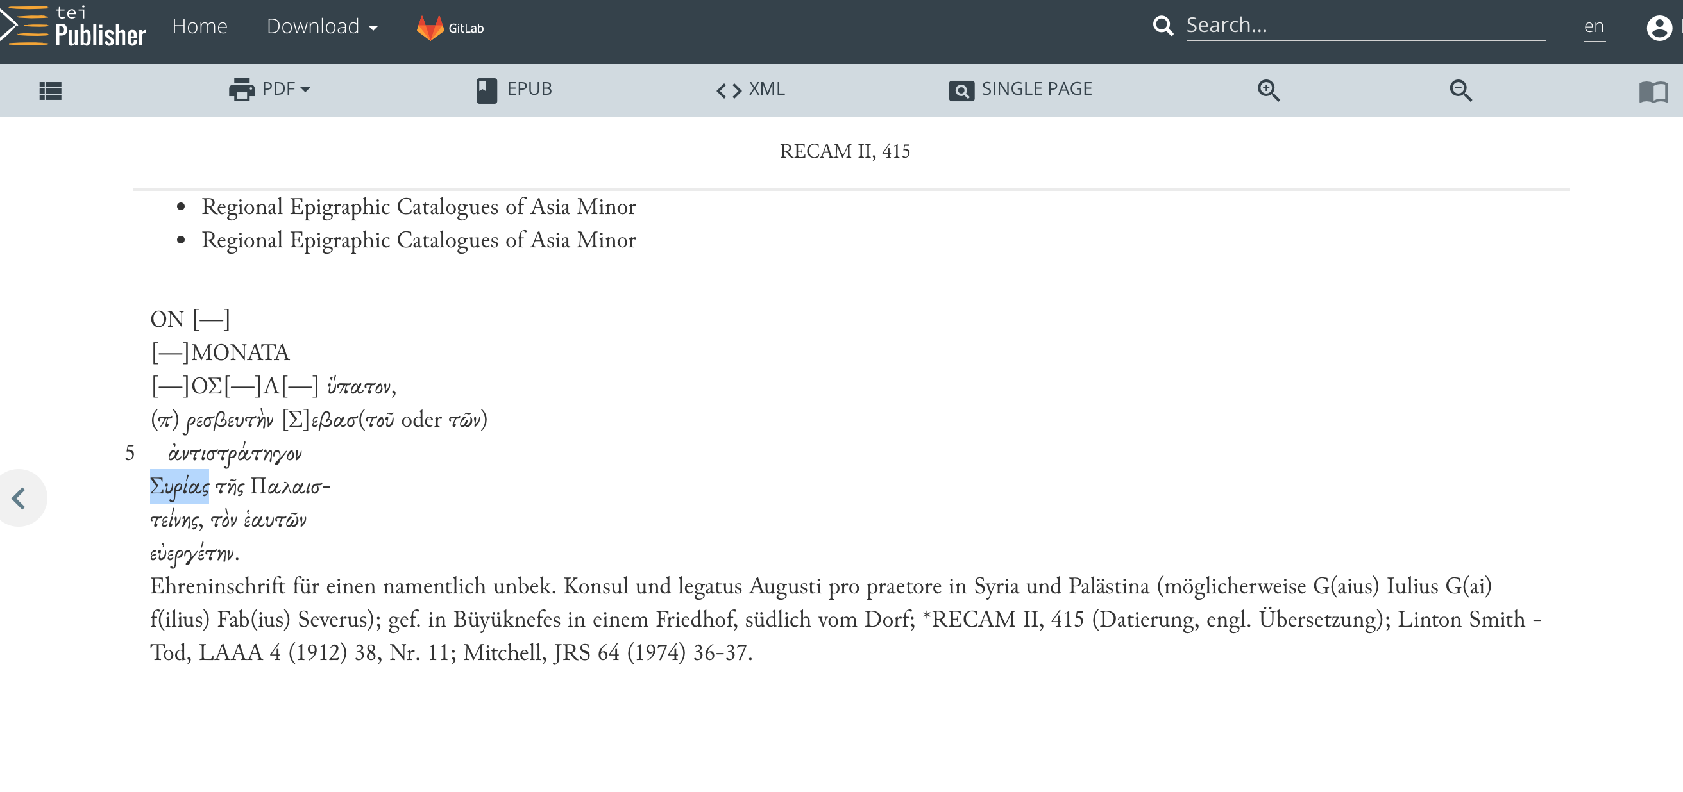

Slide 5

CETEIcean
Requires nothing but a bit of Javascript
No server side requirement for display
Works directly on your TEI in the browser
http://teic.github.io/CETEIcean/

Slide 6
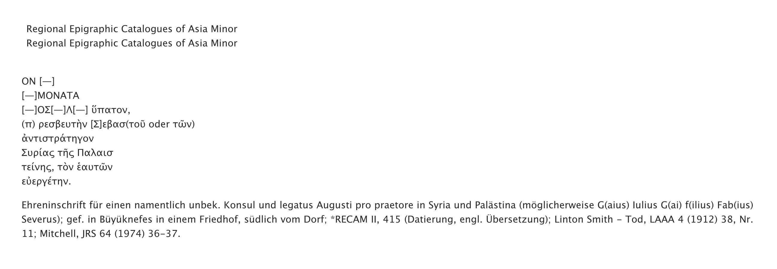

Slide 7
EFES (EpiDoc Front End Service)
Requires (1) command line to install
Data requirements on authority files
Native EpiDoc support (no need to code)
Fully featured Database and frontend (as in TEI publisher)
https://github.com/EpiDoc/EFES/wiki

Slide 8
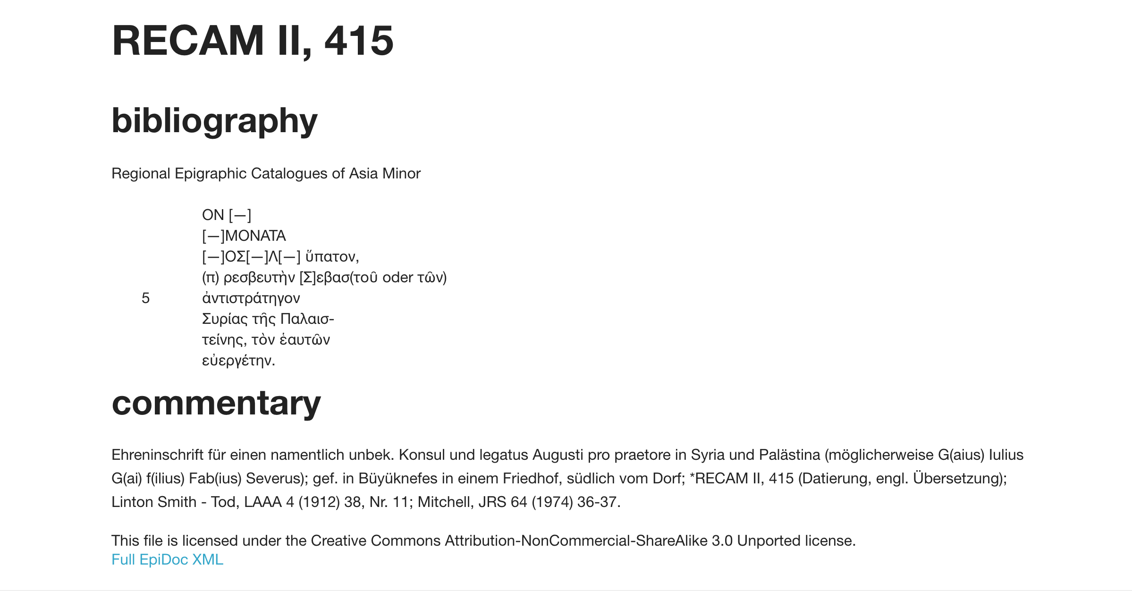

Slide 9
EpiDoc Converter API
Useful to see how it looks like
Easily test parameters from the EpiDoc Example XSLT
http://epidoc.dainst.org/

Slide 10
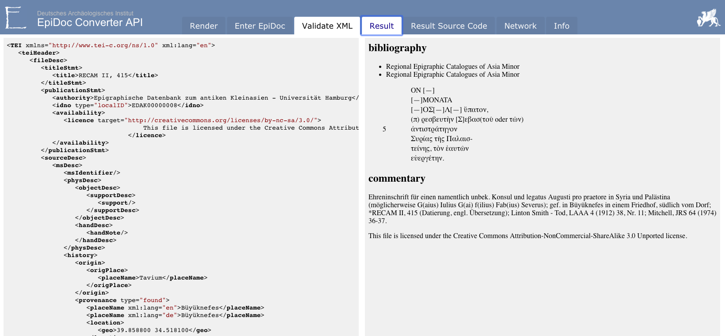

Slide 11

CapiTainS and Nemo
A full suite of guidance and support tools for publishing citable texts
Requires quite a bit of programming
To work with Nemo you need Python Flask
http://capitains.org/

Slide 12
And MANY MANY MORE!!
EVT2 http://evt.labcd.unipi.it/
Textual Communities https://textualcommunities.org/app
GitHub Pages https://pages.github.com/
Etc.

Slide 13
The bottom line
What matters is that the information is up to date and that the EpiDoc data is valid and openly accessible, it does not matter how you put it online, that is an easy task.

Slide 14
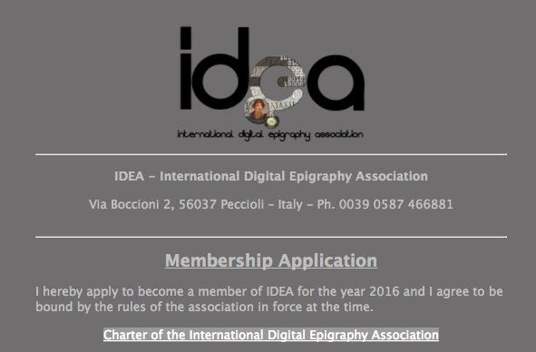
Thank you very much
Pietro Maria Liuzzo
pietro.liuzzo@uni-hamburg.de
Universität Hamburg
IDEA, International Digital Epigraphy Association
https://form.jotformeu.com/61524210874350
References
You can find all images of inscriptions in this presentations searching “EUROPA” in the EAGLE portal https://www.eagle-network.eu/basic-search/

